Slide 1


VISA TESTING

Slide 2
VISA TESTING SET-UP
VISA SETUP
PROFILE
CUCUMBER
DB-SQLITE

Slide 3
PROFILE SET-UP
PROFILE SET-UP
1.ProfileStore
Se_entity.profile
Network.profile
Brand.profile
Card_product_scheme.profile
Card_product.profile
Formatter.profile
Account_Range.profile
Procesor.profile
End_point.profile
Route.profile

Slide 4
PROFILE SET-UP
2.PlatformStore
Interchange Fees and charges:
Fee_Rules.profile
Fee_Rate.profile
Fee_group.profile
tran_type_to_fee_group.profile
Accumulation Fees and charges :
Accumultion_group_rules.profile
Accumulation_group_Fee_rate.profile
fee_rate.profie
Note:
se_end_point_attributes_score.profile
card_product_id_to_limit_mapping.profile

Slide 5
CUCUMBER SET-UP
CUCUMBER TESTING SETUP
ECLIPSE:
se_testing Repo :
Import VISA_Testing project from VISA_testing branch
Create a feature File to below path
Path :
se_testing/VISA_Testing/Src/test/resources/features
Branch Name : VISA_testing
Configure the test.properties as per ur test data and transaction details.
Write CommonStepDefintion code in below
Path :
se_testing/VISA_Testing/Src/test/java/cucumber.features/
Interchange.java or CommonStepDefintion.java

Slide 6
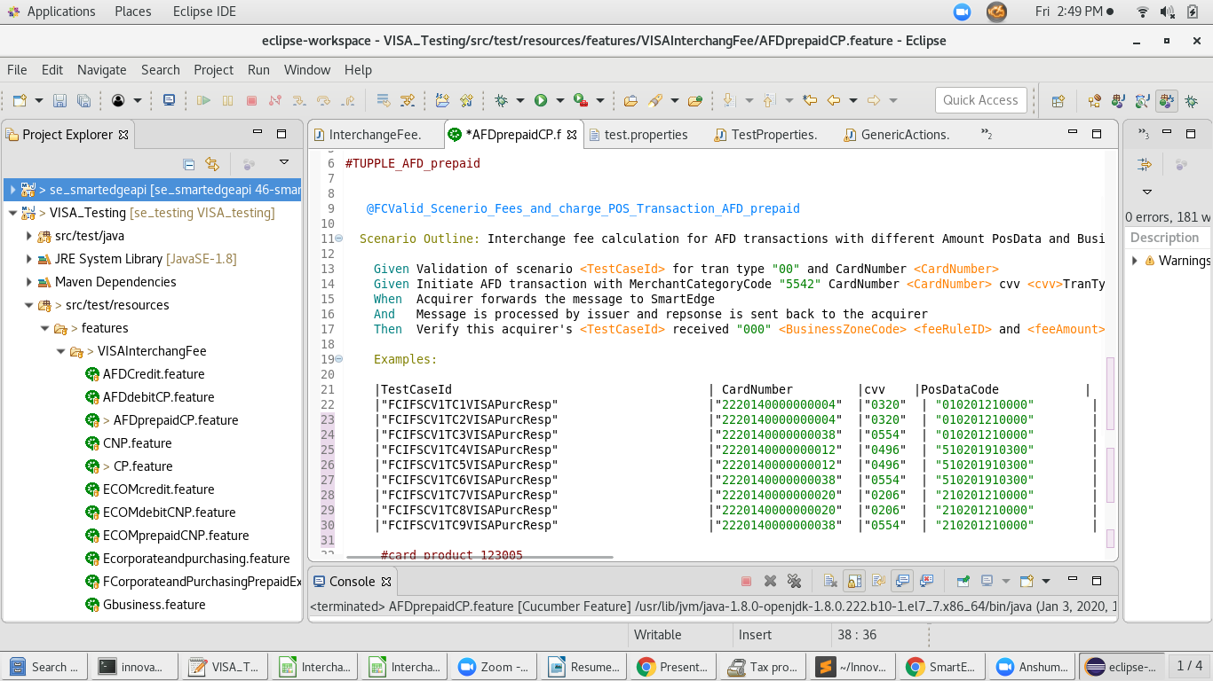
Eclipse-Se_testing Repo

Slide 7
CUCUMBER SET-UP
se_smartedgeapi Repo:
Import se_smartedgeapi project from Development
Branch Name : Development
Write Acquirer/Issuer Simulator code below path
Path :
se_smartedgeapi /Src/main/java/Com.api.simulator/AcquirerSimulator.java
se_smartedgeapi /Src/main/java/Com.api.simulator/IssuerSimulator.java
Write Generic code below path
Path:
se_smartedgeapi /Src/main/java/Com.api.common/
GenericActions.java

Slide 8
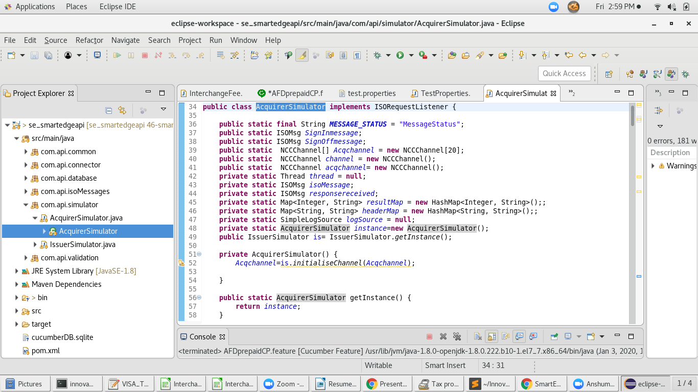
SE_SMARTEDGEAPI REPO

Slide 9
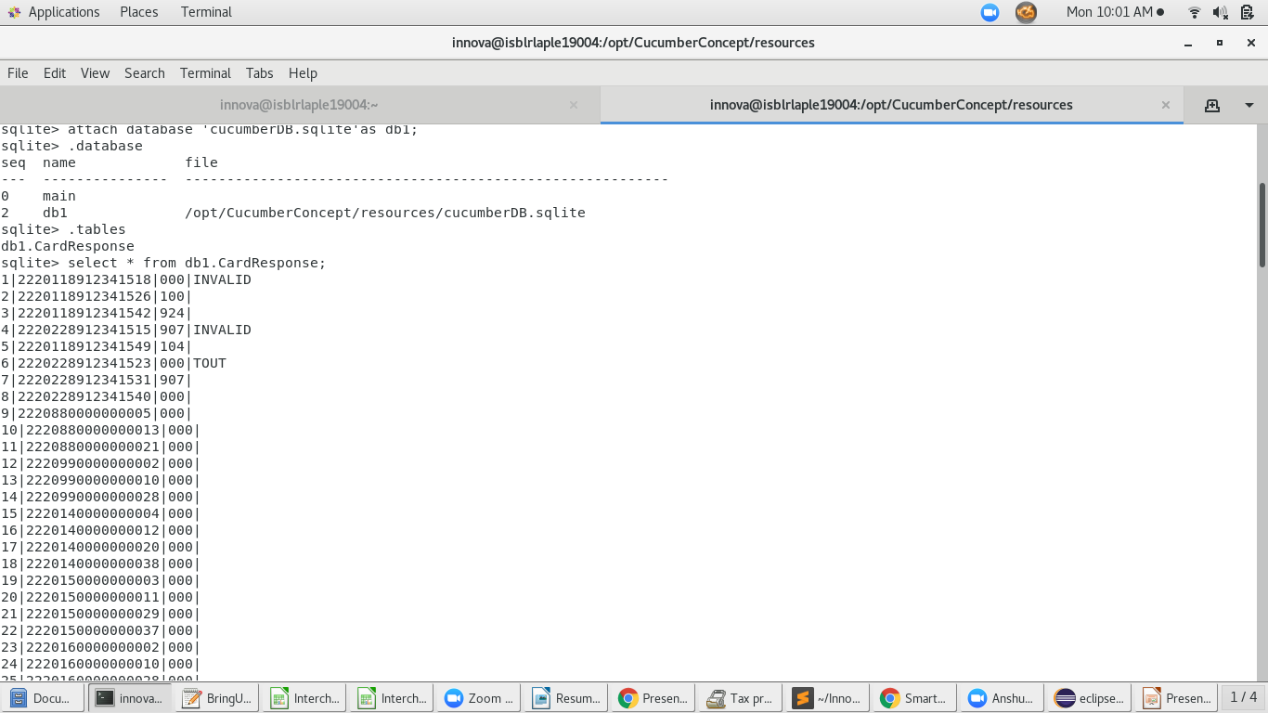
Db-SQLITE

Slide 10

Thank you
Contact Id : Monisha.manikannan@innovasolutions.com

